Slide 1

#TeamZonka

Slide 2




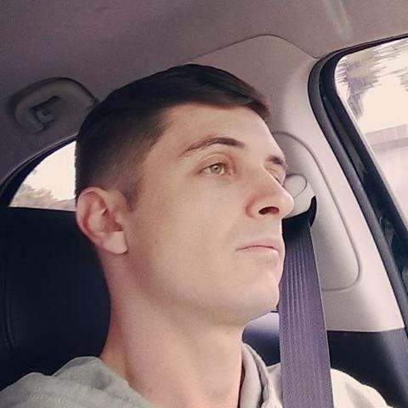


Team
Ândrei Schuch
Gabriel Fonseca
Guilherme Quadros
Edson Rocha
Pablo Parada
Game Design
Engineering
Testing
Engineering
UI
Game Design
Engineering
Testing
Script
Animation
3D Art
Animation

Slide 3
A cartoonish multiplayer zombie shoot’ em up.

Slide 4
A cartoonish multiplayer zombie shoot’ em up.
Just run and shoot!!!

Slide 5
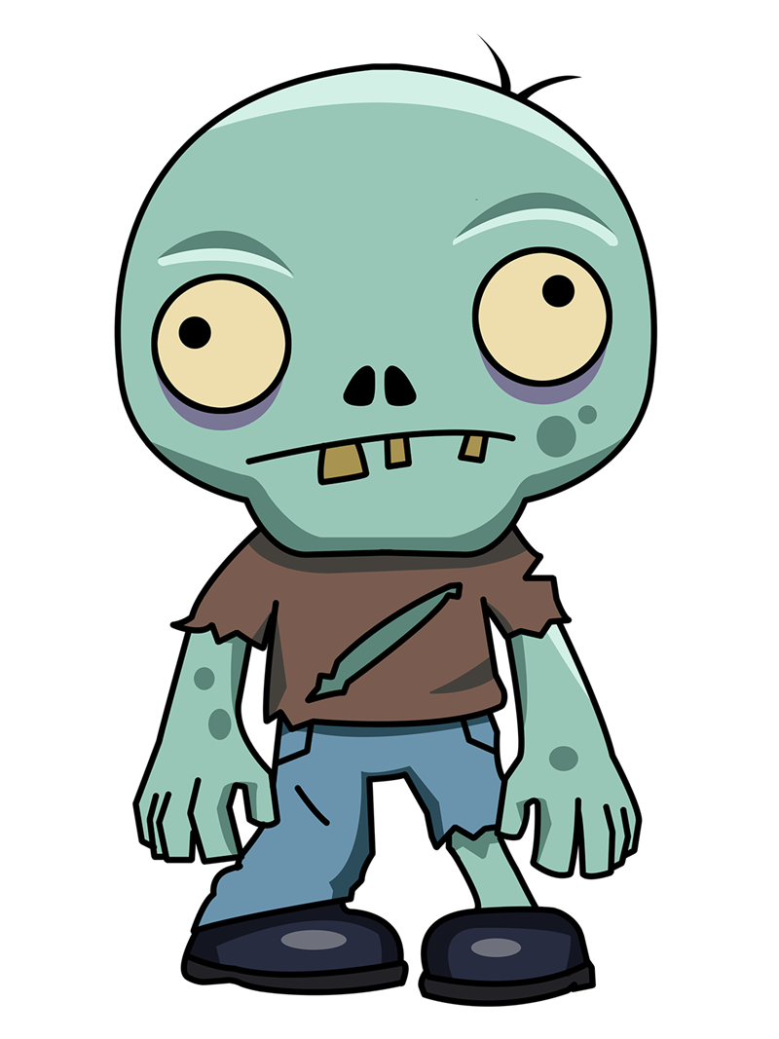

Brief
Who doesn't like chocolate?
+

Slide 6
Brief
A new chocolate just turned everyone into zombies and the city is upside down.
Notes:
Aqui o Edson deve falar sobre as inspirações para o roteiro.

Slide 7
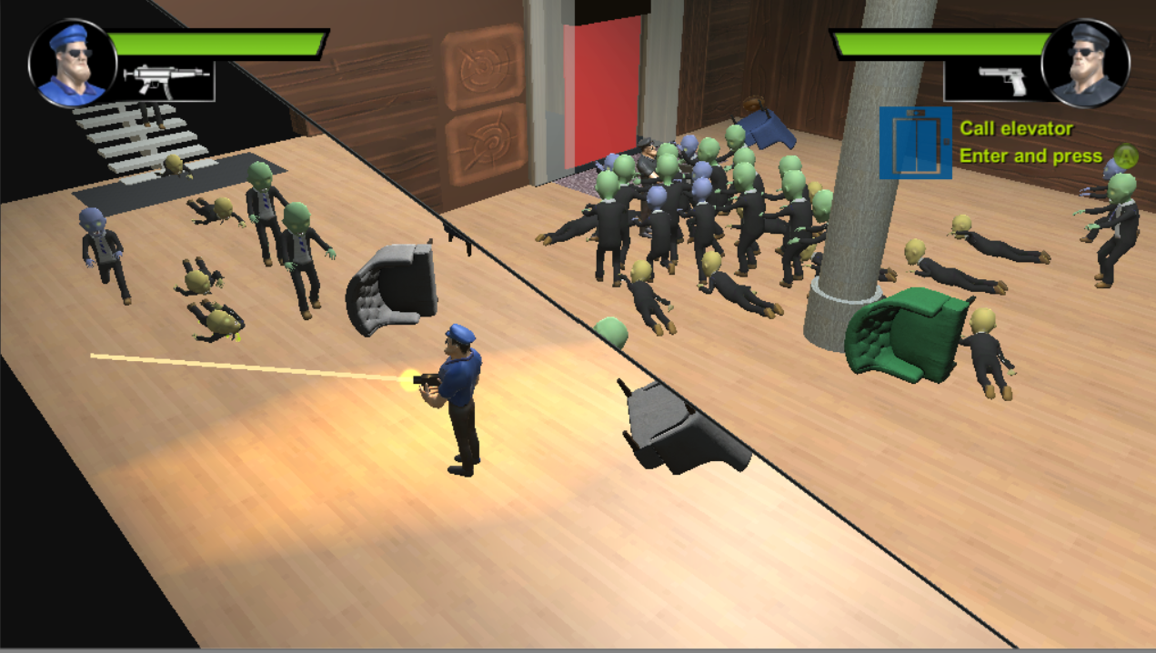
Local Multiplayer
Dynamic Split screen
Cartoonish Looking

Slide 8
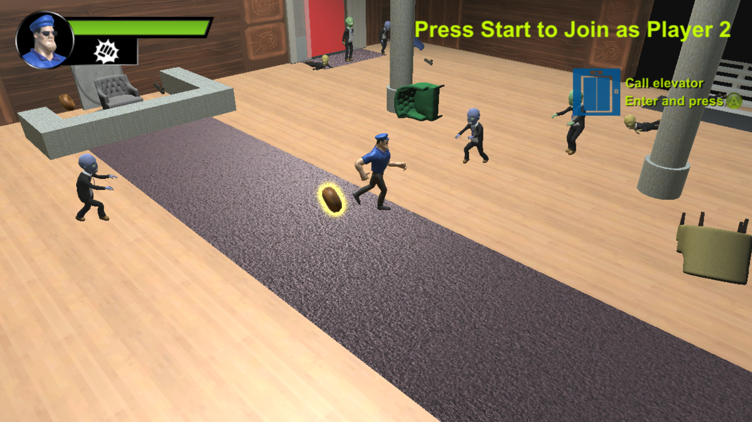
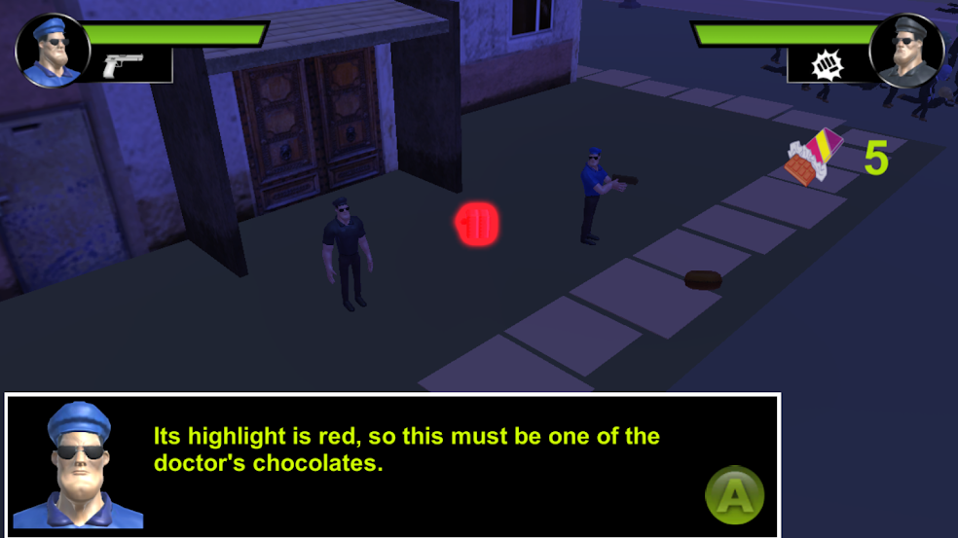
Collect Items

Slide 9
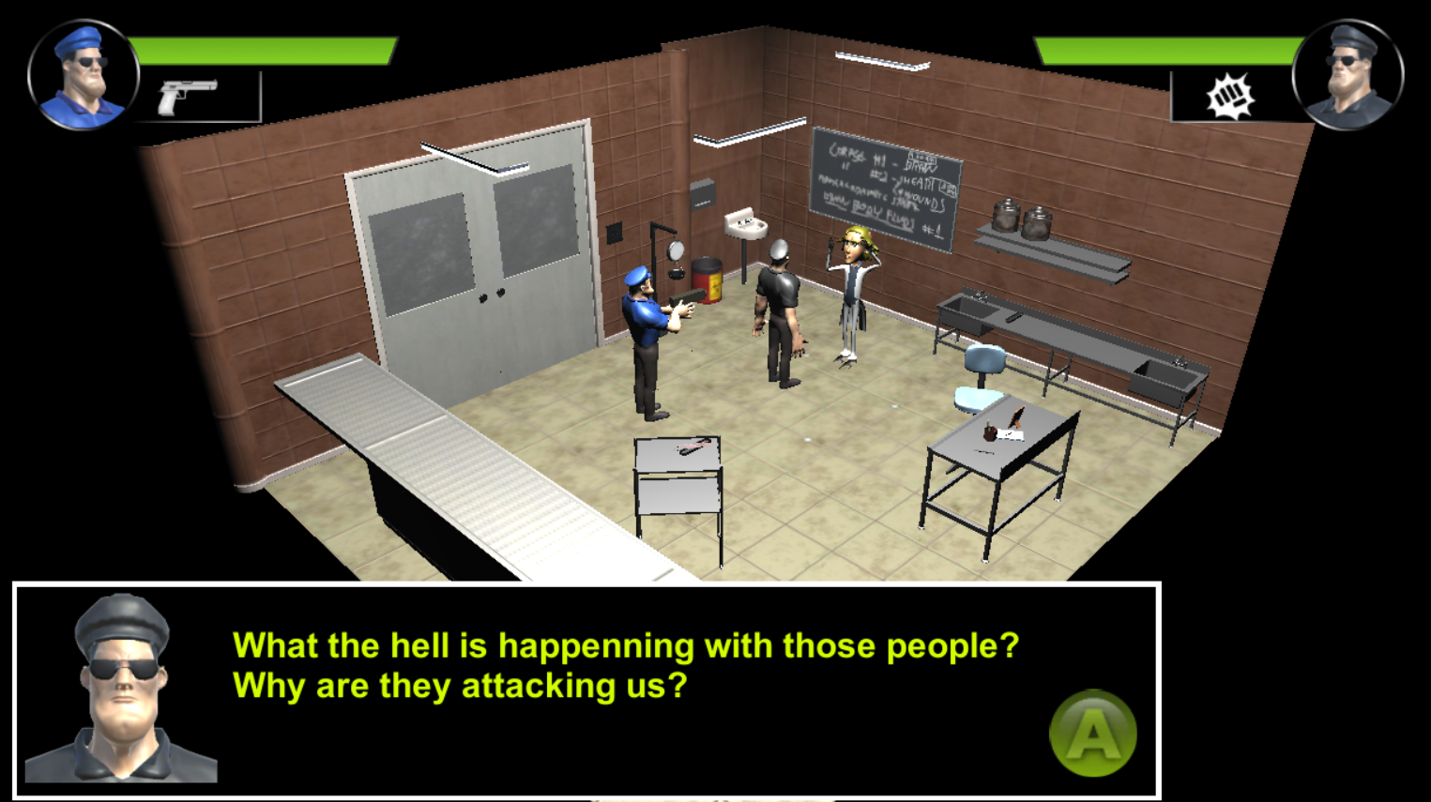
Save the day

Slide 10
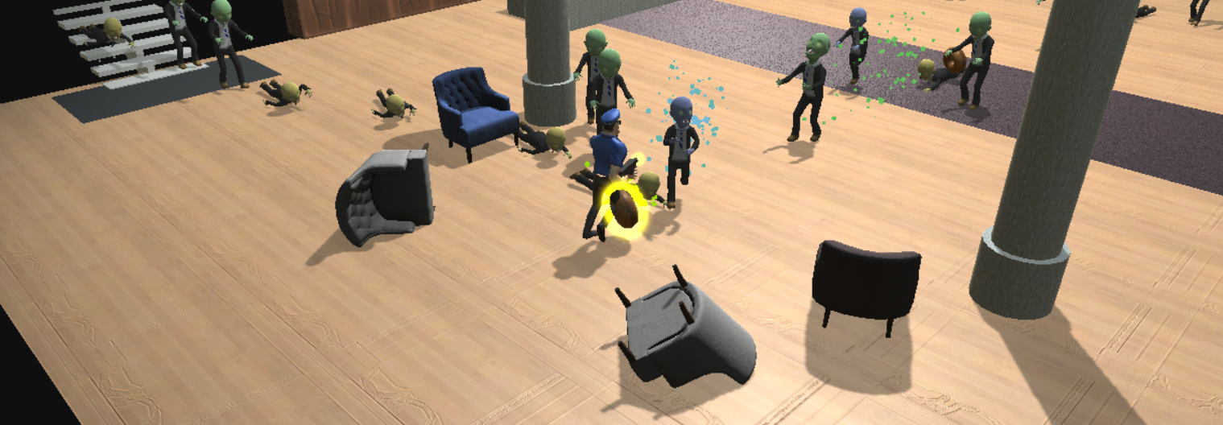
And shoot every zombie you can...

Slide 11
Game
3 types of guns
3 types of zombies
2 maps
Notes:
“to be supported” = problemas no build UWP, ao que parece uma das últimas atualizações do Windows 10 quebrou o build UWP do Unity para todas as plataformas. E para a apresentação só conseguimos gerar o build pra PC.

Slide 12
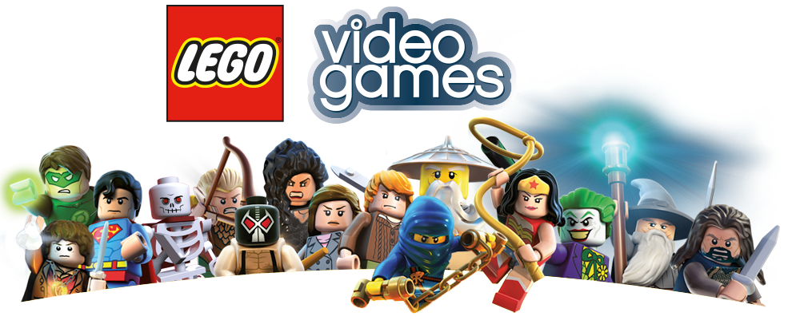
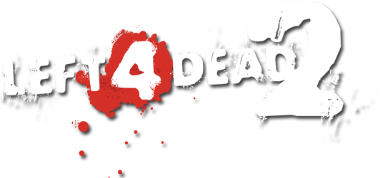
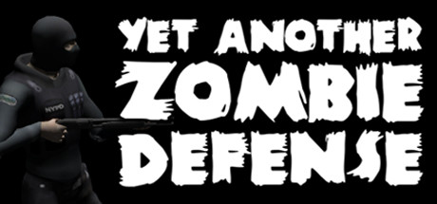
Inspirations
Lego Series
Left 4 Dead Series
Yet Another Zombie Defense
Local Multiplayer
Dynamic Split Screen
Action + Comedy
Zombie types
Zombie IA
Guns
Player movimentation
Zombie types
Guns

